Slide 1
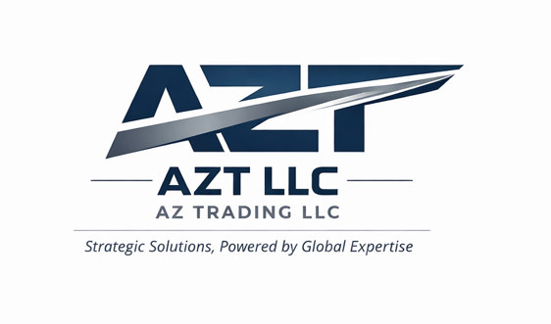

AZT LLC | Strategic Solutions, Powered by Global Expertise
AZ TRADING LLC
AZT LLC
Strategic & Operational Solutions
Aviation | Defense | Maritime | Security
AZT LLC Strategic & Operational Solutions

Slide 2

AZT LLC | Strategic Solutions, Powered by Global Expertise
Executive Positioning
AZT LLC structures and delivers integrated capability programs across aviation, defense, maritime, security, and industrial support environments.
We act as a single coordination point between global suppliers and institutional, commercial, and humanitarian clients.
Our model combines strategic structuring, operational execution, and long-term sustainment in one accountable platform.
Built for complex, regulated, and mission-critical requirements.
AZT LLC Strategic & Operational Solutions

Slide 3
AZT LLC | Strategic Solutions, Powered by Global Expertise
The AZT Difference
“We assemble the entire ecosystem into a working solution.”
Global access
Program integration
Operational outcome
Aircraft, systems, equipment, and specialist partners
→
Configuration, compliance, logistics, and delivery management
→
Mission-ready capability with training and sustainment
AZT LLC Strategic & Operational Solutions

Slide 4
AZT LLC | Strategic Solutions, Powered by Global Expertise
Client Ecosystem
Private operators
& commercial groups
Governments
& public entities
NGOs &
humanitarian missions
AZT LLC
Security & critical
infrastructure firms
Emergency response
and disaster relief
Industrial, energy,
and specialized programs
AZT LLC Strategic & Operational Solutions

Slide 5
AZT LLC | Strategic Solutions, Powered by Global Expertise
Core Capability Portfolio
Aviation
Defense
Rotary and fixed-wing platforms
Mission configuration
MRO and lifecycle support
Weapons systems
Ammunition and vehicles
Integrated defense packages
Maritime
Security
Offshore patrol vessels
Coastal surveillance
Maritime security support
Critical infrastructure protection
Monitoring and response systems
Specialized field support
AZT LLC Strategic & Operational Solutions

Slide 6
AZT LLC | Strategic Solutions, Powered by Global Expertise
Aviation Capability Programs
Mission-ready aviation solutions structured around platform access, configuration, deployment, and sustainment.
Platforms
Integration
Sustainment
Fixed-wing and rotary aircraft
Black Hawk and Mi-series opportunities
Special mission and utility configurations
Avionics and systems upgrades
Mission package alignment
Operational documentation support
MRO and lifecycle services
Training and readiness enablement
Spare parts and long-term support
Use cases: SAR | Medevac | Patrol | Utility support
AZT LLC Strategic & Operational Solutions

Slide 7
AZT LLC | Strategic Solutions, Powered by Global Expertise
Integrated Defense, Maritime & Security Solutions
Defense
Maritime
Security
Weapons systems and ammunition
Armored and specialized vehicles
Program-level delivery for regulated environments
OPV and coastal surveillance support
Maritime security program structuring
Coordination across suppliers and services
Critical infrastructure protection
Monitoring, response, and field support
Industrial and specialized operational solutions
Designed for public, commercial, and humanitarian operating contexts.
AZT LLC Strategic & Operational Solutions

Slide 8
AZT LLC | Strategic Solutions, Powered by Global Expertise
Global Reach & Strategic Presence
Europe
Americas
Middle East
Caribbean
Flexible partner network supporting cross-border programs, regulated delivery, and localized execution where required.
AZT LLC Strategic & Operational Solutions

Slide 9
AZT LLC | Strategic Solutions, Powered by Global Expertise
Why AZT
We do not deliver isolated products.
We deliver integrated operational capability.
Single point of accountability across multiple suppliers and workstreams
Full-cycle support from structuring and sourcing to deployment and sustainment
Adaptable for government, commercial, humanitarian, and industrial applications
AZT LLC Strategic & Operational Solutions

Slide 10
AZT LLC | Strategic Solutions, Powered by Global Expertise
Closing
Mission-ready capability assembled and delivered end-to-end
Strategic vision paired with operational execution
AZT LLC
Strategic & Operational Solutions
AZT LLC Strategic & Operational Solutions

